Slide 1
NBA Rookie Second-Contract Salary Predictions
Stephen Ilhardt

Slide 2
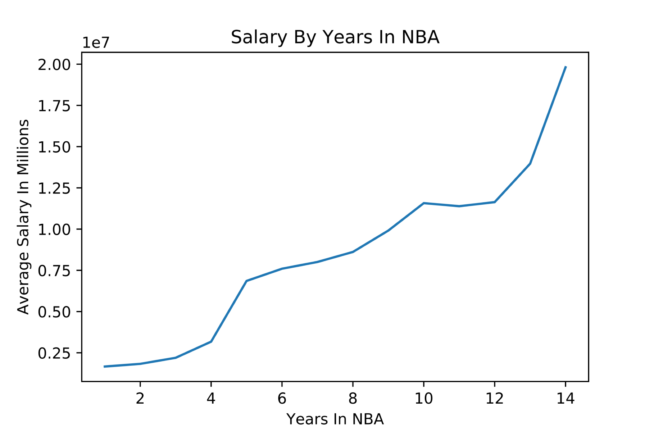
Objective
Good general managers plan ahead

Slide 3
Data Sources
Salaries
Draft Data (2005-2014)
Basic Statistics
Advanced Statistics

Slide 4
Methods
Regression
Prediction
Interpretation

Slide 5
Key Statistics
Games Started
Three Point Percentage
Free Throw Attempts
Free Throw Percentage
Steals
Blocks
Turnovers
Value-Over-Replacement-Player
Defensive Box Plus-Minus

Slide 6
CV Scores
R-Squared By Data Set
Per 36 Minutes: 0.1613
Total: 0.1323
Per Game: 0.1292

Slide 7
Interpretation
Rookie second contract salaries are hard to formally predict using player statistics
Less than half of rookies (258 of 600) continue to play in the NBA after four years
Looking at key statistics in 36-minute periods may be a good test

Slide 8
Future Work
Determine what does explain variance in second-contract salaries
Determine Estimated Over-/Undervaluation of player for second contract

Slide 9
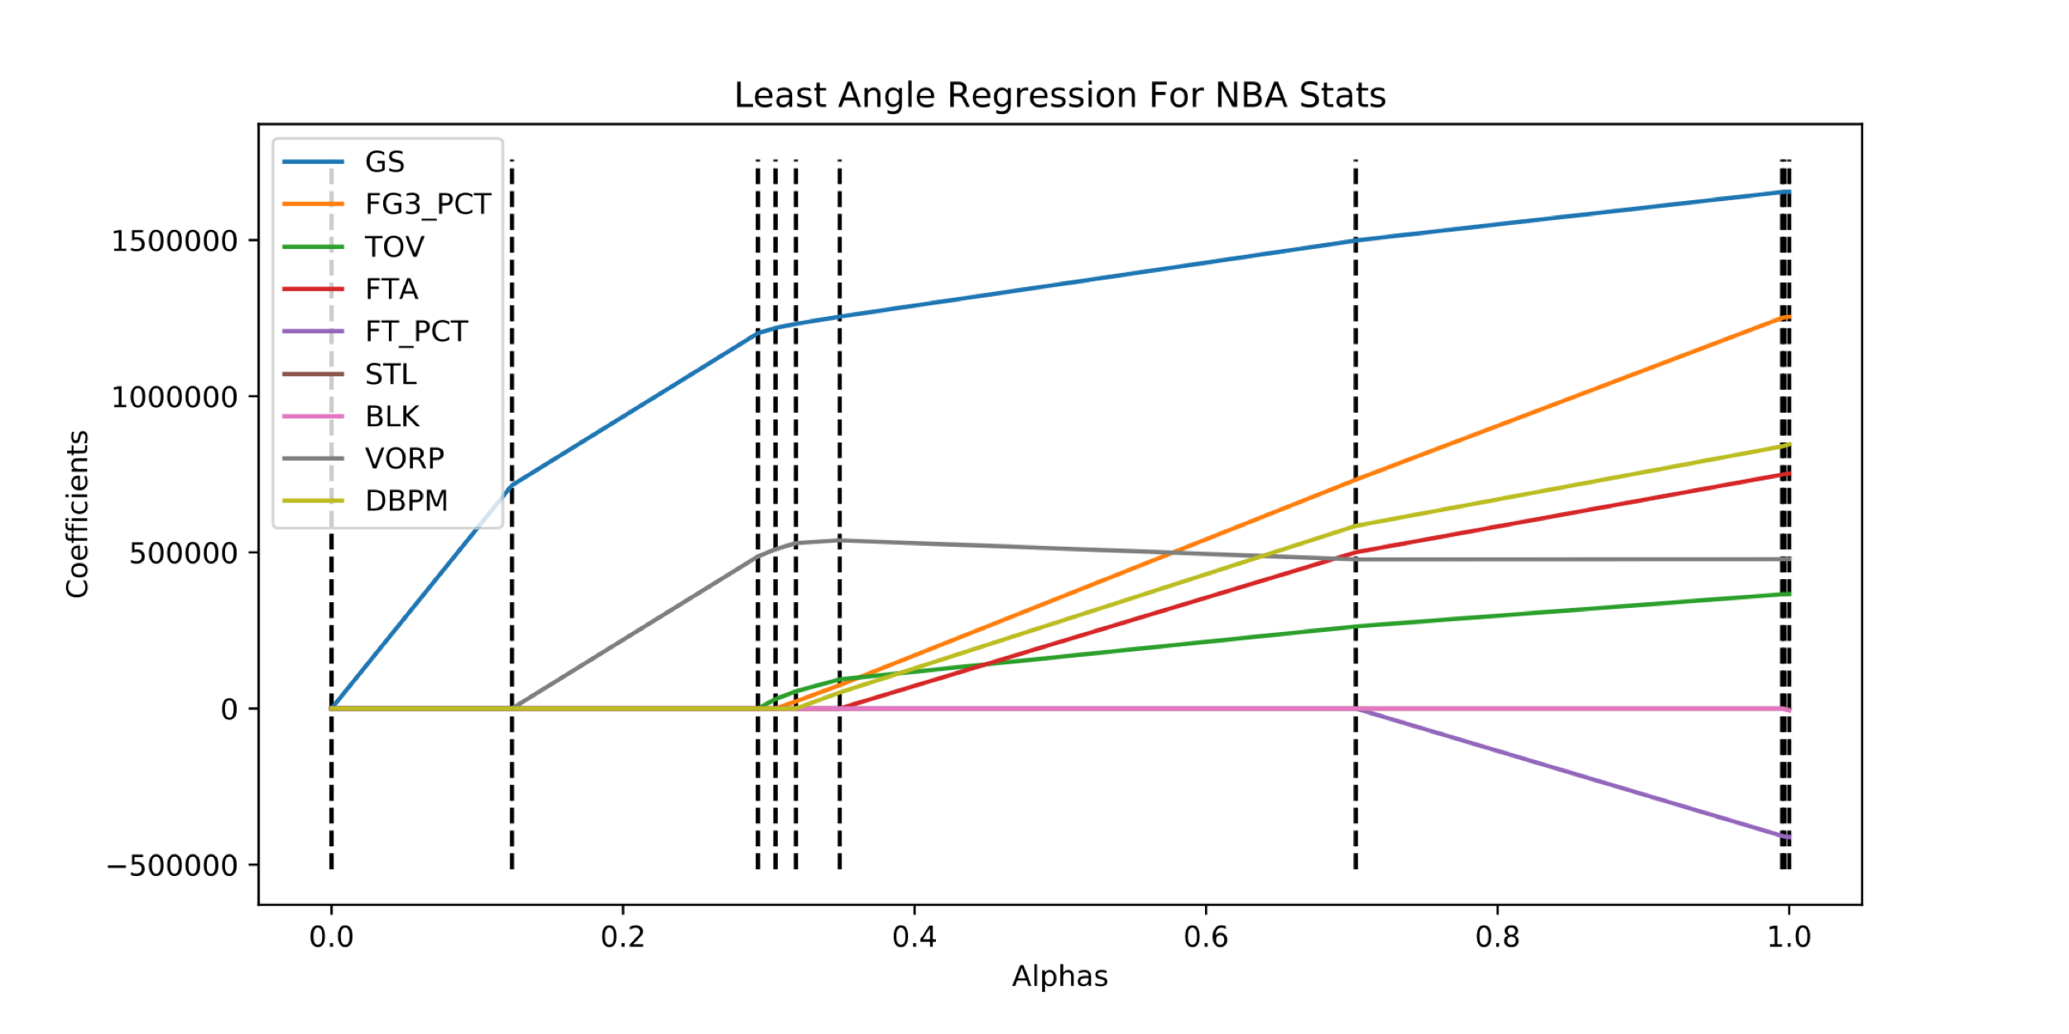
Appendix

Slide 10
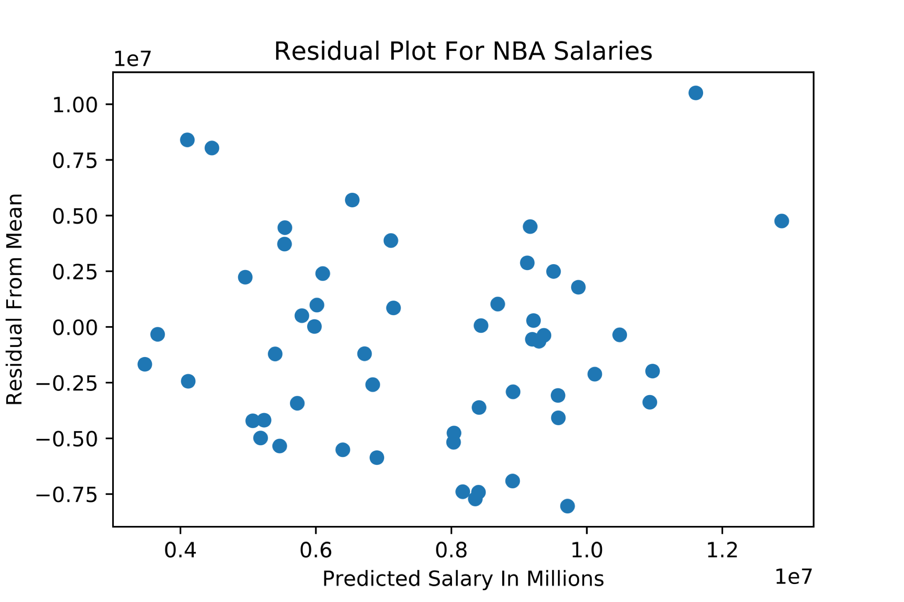
Appendix

Slide 11
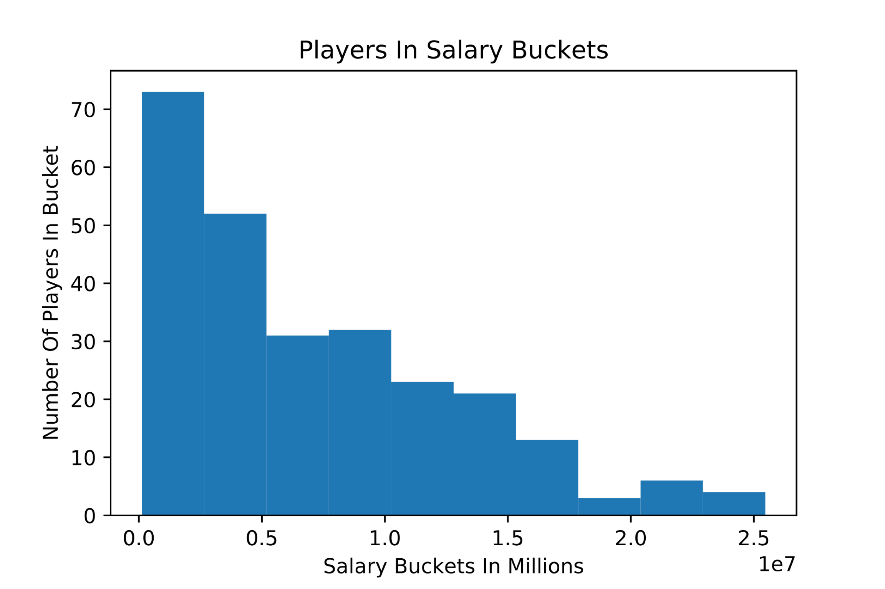
Appendix

Slide 12
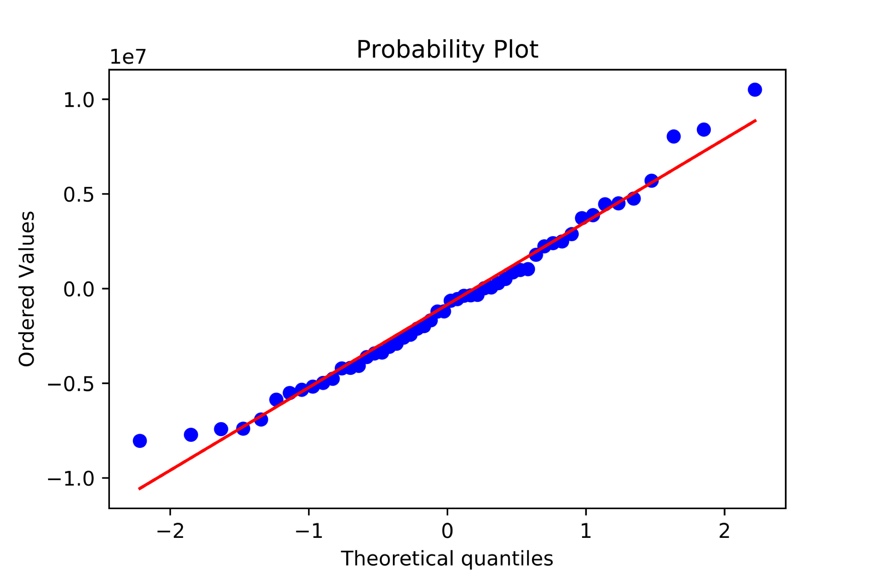
Appendix

